Slide 1
IE 598 Optimization Methods for Large-scale Network-based Systems
Lecture Set 4: Column Generation
Department of Industrial and Enterprise Systems Engineering
University of Illinois at Urbana-Champaign

Slide 2
Example
Find: Resource-constrained shortest path from 1 to 6 Total traversal time must not exceed 14 units.
2
(1,1)
4
(1,10)
(2,3)
(1,7)
Source node s
1
(1,2)
6
Sink node
t
(10,1)
(10,3)
(5,7)
(2,2)
3
5
(12,3)
Path 1-3-5-6 is quick but expensive: cost 24, time 8
Path 1-2-4-6 is cheap but too slow: cost 3, time 18
Path 1-3-2-4-6 is optimal: cost 13, time 13
How do we find out?

Slide 3


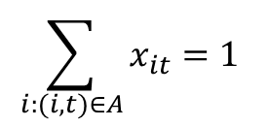


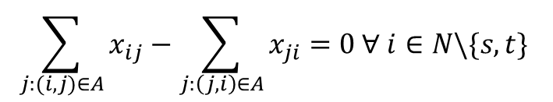

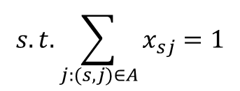
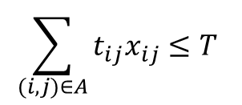
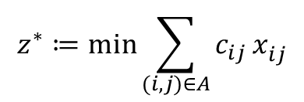

Integer Programming Formulation
$$c_{ij}^{}$$
$${= cost on arc \left(i,j\right)}_{}^{}$$
$$t_{ij}^{}$$
$$= Travel {time for arc \left(i,j\right)}_{}^{}$$
$$T=14$$
$${z^{∗}≔\min{\sum_{(i,j)∈A}{c_{ij}}}x}_{ij}^{}$$
$$s.t. \sum_{j:(s,j)∈A}{x_{sj}}=1$$
$$\sum_{j:(i,j)∈A}{x_{ij}}−\sum_{j:\left(j,i\right)∈A}{x_{ji}}=0 ∀ i∈N\backslash \{s,t\}$$
$$\sum_{i:(i,t)∈A}{x_{it}}=1$$
$$\sum_{(i,j)∈A}{t_{ij}x_{ij}}≤T$$
$$x_{ij}∈\left\{0,1\right\} ∀ (i,j)∈A$$

Slide 4
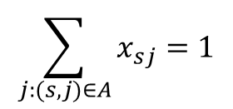
Integer Programming Formulation
$$\sum_{j:(s,j)∈A}{x_{sj}}=1$$
$$\sum_{j:(i,j)∈A}{x_{ij}}−\sum_{j:\left(j,i\right)∈A}{x_{ji}}=0 ∀ i∈N\backslash \{s,t\}$$
$$\sum_{i:(i,t)∈A}{x_{it}}=1$$
$$x_{ij}∈\left\{0,1\right\} ∀ (i,j)∈A$$
This problem defines a (pure) network flow problem.
This formulation defines a polyhedron with integer vertices (unimodularity).
Flow decomposition theorem: Every non-negative flow can be decomposed into flows on paths and cycles. Every (fractional) flow can thus be represented as a convex combination of path and cycle flows

Slide 5
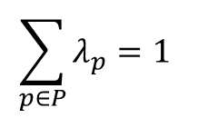
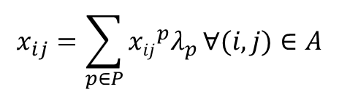

Path-based IP formulation
Flow decomposition theorem: Every non-negative flow can be decomposed into flows on paths and cycles. Every (fractional) flow can thus be represented as a convex combination of path and cycle flows
$$x_{ij}=\sum_{p∈P}{{xij}_{}^{p}λ_{p}}∀(i,j)∈A$$
$$\sum_{p∈P}{λ_{p}}=1$$
Convexity constraint
$$λ_{p}≥0 ∀ p ∈P$$

Slide 6
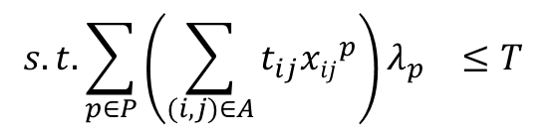
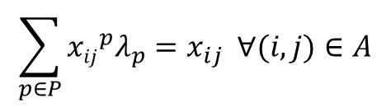
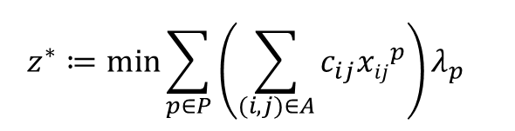

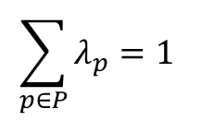

Path-based formulation
$${z^{∗}≔\min{\sum_{p∈P}{\left(\sum_{(i,j)∈A}{c_{ij}{xij}_{}^{p}}\right)λ_{p}}}}_{}^{}$$
$$s.t.\sum_{p∈P}{{\left(\sum_{(i,j)∈A}{{t_{ij}xij}_{}^{p}}\right)λ_{p}}_{}}≤T$$
$$\sum_{p∈P}{λ_{p}}=1$$
$$λ_{p}≥0 ∀ p ∈P$$
$$\sum_{p∈P}{{xij}_{}^{p}λ_{p}}=x_{ij} ∀(i,j)∈A$$
$$x_{ij}∈\left\{0,1\right\} ∀ (i,j)∈A$$
Integrality must be preserved for $x_{ij}$variables

Slide 7
Which formulation is better?
Depends on how we solve the models
Both are integer programs
Solved using methods that build upon the basic branch-and-bound algorithm
Typically path-based formulations have many more variables
More integer variables, harder?
Sometimes special properties arise in network-based problems because of the fundamental structure
For special structures, linear optimal solutions are integral!
Exploits a special structure called unimodularity
Not the case for the problems we are considering
Need to think about how to solve integer, large-scale problems

Slide 8
Integer Large-scale problems
Integer problems
Branch-and-bound
Large-scale formulations
Linear programs
Not listing/enumerating all variables
Column generation
Integer+Large-scale problems
Combine branch-and-bound with column generation

Slide 9
BRANCH-AND-BOUND

Slide 10
Solving an IP – Branch-and-bound
λ₁= 1
λ₁= 0
λ₂= 1
λ₂= 0
λ₂= 1
λ₂= 0
λ₃= 1
λ₃= 0
All possible solutions at leaf nodes of tree (2^{n} solutions, where n is the number of variables)

Slide 11
Branch-and-Bound: A Solution Approach for Integer Programs
Branch-and-Bound is a smart enumeration strategy:
With branching, all possible solutions (e.g., 2number of paths for all commodities) are enumerated
With bounding, only a (usually) small subset of possible solutions are evaluated before a provably optimal solution is found

Slide 12
Bounding: The Linear Programming (LP) Relaxation
Consider the linear path-based problem formulation
Objective is to minimize
The LP relaxation replaces
λ_{p} ∈ 0,1
with
1 ≥ λ_{p} ≥ 0
Let z_{LP}* represent the optimal LP solution and let z_{IP}* represent the optimal IP solution
z_{LP}* ≤ z_{IP}*
LP’s provide a bound on the lowest possible value of the optimal integer solution

Slide 13
Branching
Consider an IP with binary restrictions on all variables, denoted P(1)
Let LP(1) denote the linear programming relaxation of P(1) and let x*(1) denote the optimal solution to LP(1)
If there is no variable with fractional value in x*(1), x*(1) solves (is optimal for) P(1)
If there is at least one variable with fractional value in x*(1), call it x_{l}*(1), then any optimal solution for P(1) has x_{l}*(1)=0 or x_{l}*(1)=1
Left branch: x_{l}*(1)=0
Right branch: x_{l}*(1)=1

Slide 14
A Pictorial View
feasible IP
feasible LP

Slide 15
Relationship between Bound and Tree Depth
Let x*(1) be the optimal solution to LP(1) with at least one fractional variable x_{l}*(1)
Let the optimal solution value for LP(1) be denoted z*(1)
Let LP(2) = LP(1) + [x_{l}*(1) = 0 or x_{l}*(1) = 1]
Let the optimal solution value for LP(2) be denoted z*(2)
Then
z*(1) ≤ z*(2)

Slide 16
Tree pruning
Incumbent: Current best
feasible (IP) solution value = z_{IP}
λ₁= 1
λ₁= 0
λ₂= 1
λ₂= 0
λ₂= 1
λ₂= 0
λ₃= 1
λ₃= 0
If z*(LP(2)) ≥ z_{IP}, PRUNE (FATHOM) tree at node 2 (solutions on the LHS of tree cannot be optimal. 1/2 of the solutions (nodes) do not need to be evaluated!)
If z*(LP(2)) is integral, PRUNE tree at node 2 (solutions in sub-tree at node 2 cannot be better.)
If LP(2) is infeasible, PRUNE tree at node 2 (solutions in sub-tree at node 2 cannot be feasible.)

Slide 17
Branch-and-Bound Algorithm
Beginning with rootnode (minimization):
Bound:
Solve the current LP with this and all restrictions along the (back) path to the rootnode enforced
Prune:
If optimal LP value is greater than or equal to the incumbent solution: Prune
If LP is infeasible: Prune
If LP is integral: Prune and update incumbent solution
Branch:
Set some variable to an integer value
Repeat until all nodes pruned

Slide 18
COLUMN GENERATION

Slide 19

Solving the Path-based formulation – Root Node Relaxation (Master Problem)
$${z^{∗}≔\min{\sum_{p∈P}{\left(\sum_{(i,j)∈A}{c_{ij}{xij}_{}^{p}}\right)λ_{p}}}}_{}^{}$$
$$s.t.\sum_{p∈P}{{\left(\sum_{(i,j)∈A}{{t_{ij}xij}_{}^{p}}\right)λ_{p}}_{}}≤T$$
$$\sum_{p∈P}{λ_{p}}=1$$
$$λ_{p}≥0 ∀ p ∈P$$
$$\sum_{p∈P}{{xij}_{}^{p}λ_{p}}=x_{ij} ∀(i,j)∈A$$
Can remove these constraints as integrality relaxed
$$x_{ij}≥0 ∀ (i,j)∈A$$
In this example we have only 9 paths, in general we will have gazillions of them..

Slide 20
Can we include all the paths in the formulation?
$${\min{{3λ}_{1246}+14λ_{12456}+{5λ}_{1256}+13λ_{13246}+24λ_{132456}+{15λ}_{13256}+16λ_{1346}+27λ_{13456}+24λ_{1356}}}_{}^{}$$
$${s.t.{18λ_{1246}+{14λ}_{12456}+{15λ}_{1256}+13λ_{13246}+9λ_{132456}+{10λ}_{13256}+17λ_{1346}+13λ_{13456}+8λ_{1356}≤14}}_{}^{}$$
$${{λ_{1246}+λ_{12456}+λ_{1256}+λ_{13246}+λ_{132456}+λ_{13256}+λ_{1346}+λ_{13456}+λ_{1356}=1}}_{}^{}$$
$${{λ_{1246},λ_{12456},λ_{1256},λ_{13246},λ_{132456},λ_{13256},λ_{1346},λ_{13456},λ_{1356}≥0}}_{}^{}$$
Idea: Work with a small subset of variables. This much smaller LP is called the Restricted Master Problem (RMP)

Slide 21
Restricted Master Problem
$${\min{{3λ}_{1246}+14λ_{12456}+{5λ}_{1256}+13λ_{13246}+24λ_{132456}+{15λ}_{13256}+16λ_{1346}+27λ_{13456}+24λ_{1356}}}_{}^{}$$
$${s.t.{18λ_{1246}+{14λ}_{12456}+{15λ}_{1256}+13λ_{13246}+9λ_{132456}+{10λ}_{13256}+17λ_{1346}+13λ_{13456}+8λ_{1356}≤14}}_{}^{}$$
$${{λ_{1246}+λ_{12456}+λ_{1256}+λ_{13246}+λ_{132456}+λ_{13256}+λ_{1346}+λ_{13456}+λ_{1356}=1}}_{}^{}$$
$${{λ_{1246},λ_{12456},λ_{1256},λ_{13246},λ_{132456},λ_{13256},λ_{1346},λ_{13456},λ_{1356}≥0}}_{}^{}$$
Idea: Work with a small subset of variables. This much smaller LP is called the Restricted Master Problem (RMP)
Will this give us an optimal solution? If so, in what cases does it give us the optimal solution? How can we prove it?

Slide 22
Reflect on the concept of optimality (primal and dual optimality)
Primal problem
In previous slide.
Dual problem
A dual variable for each constraint in the primal
Can define reduced costs for each primal variable considering the relationship between the primal and the dual
How do we find if a solution is optimal or not?
Look at the values of the reduced costs. If there is a variable with negative reduced cost (in a minimization problem) it has the potential to improve the objective
So how does this property help for column generation?

Slide 23
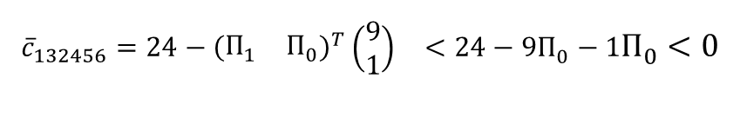


Restricted Master Problem
How can we generate a column we do not know?
$${\min{{3λ}_{1246}+14λ_{12456}+{5λ}_{1256}+13λ_{13246}+24λ_{132456}+{15λ}_{13256}+16λ_{1346}+27λ_{13456}+24λ_{1356}}}_{}^{}$$
$${s.t.{18λ_{1246}+{14λ}_{12456}+{15λ}_{1256}+13λ_{13246}+9λ_{132456}+{10λ}_{13256}+17λ_{1346}+13λ_{13456}+8λ_{1356}≤14}}_{}^{}$$
$$Π_{1}^{}$$
$${{λ_{1246}+λ_{12456}+λ_{1256}+λ_{13246}+λ_{132456}+λ_{13256}+λ_{1346}+λ_{13456}+λ_{1356}=1}}_{}^{}$$
$$Π_{0}^{}$$
$${{λ_{1246},λ_{12456},λ_{1256},λ_{13246},λ_{132456},λ_{13256},λ_{1346},λ_{13456},λ_{1356}≥0}}_{}^{}$$
In the simplex method: Variable that enters the basis must have negative reduced cost, i.e.:
$${{\overline{c}}_{132456}=24−{\left(\begin{matrix}Π_{1}^{} & Π_{0}^{}\end{matrix}\right)}^{T}\left(\begin{matrix}9 \\ 1\end{matrix}\right)}_{}^{}<24−9Π_{0}^{}−1Π_{0}^{}<0$$

Slide 24

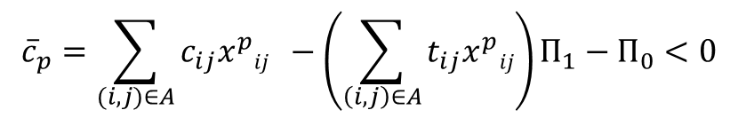


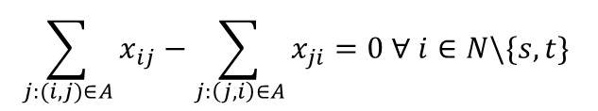

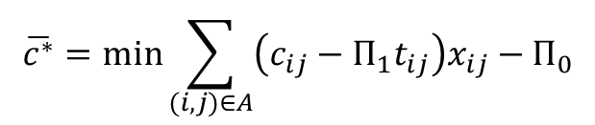
Pricing sub-problem
Check if there is a variable $λ_{p}^{}$ with
This can be cast as an optimization problem, the pricing sub-problem:
$${\overline{c}}_{p}=\sum_{(i,j)∈A}{c_{ij}{x_{}^{p}ij}_{}−\left(\sum_{\left(i,j\right)∈A}{t_{ij}x_{}^{p}ij}\right)Π_{1}−Π_{0}<0}$$
$$\overline{c^{∗}}=min\sum_{(i,j)∈A}{\left(c_{ij}−{Π_{1}t}_{ij}\right)x_{ij}−Π_{0}}$$
$$\sum_{j:(s,j)∈A}{x_{sj}}=1$$
$$\sum_{j:(i,j)∈A}{x_{ij}}−\sum_{j:\left(j,i\right)∈A}{x_{ji}}=0 ∀ i∈N\backslash \{s,t\}$$
$$\sum_{i:(i,t)∈A}{x_{it}}=1$$
$$x_{ij}≥0 ∀ (i,j)∈A$$

Slide 25
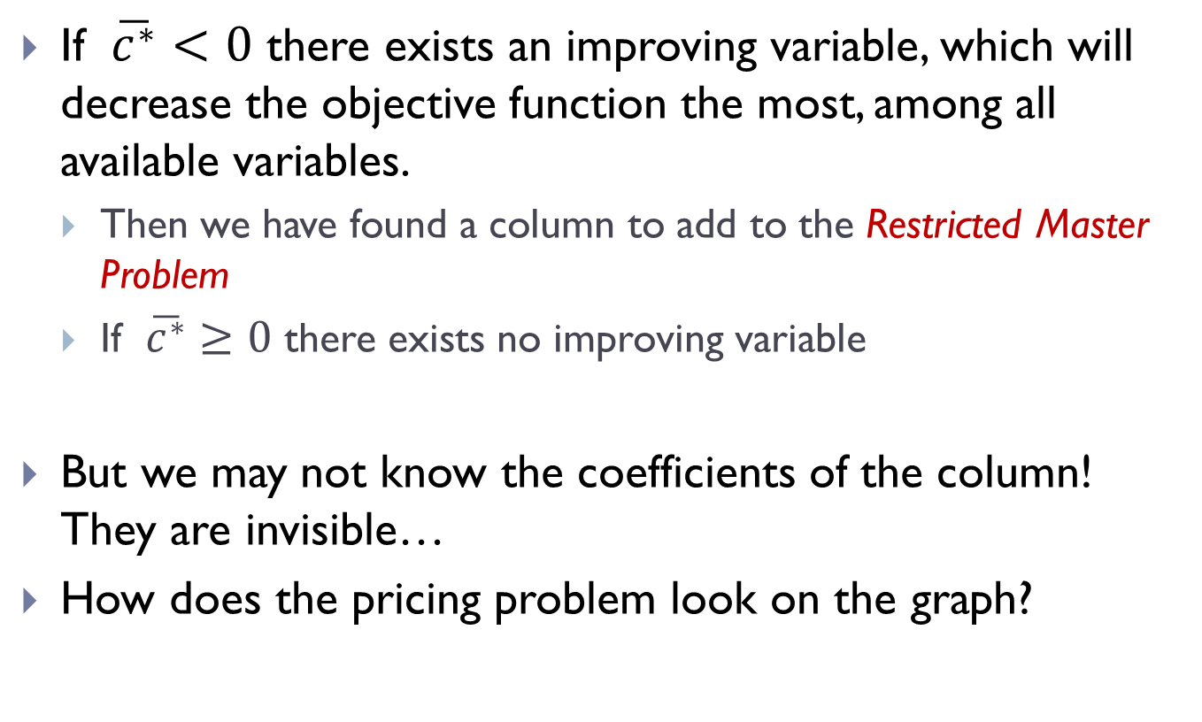
Pricing sub-problem
If $\overline{c^{∗}}<0$ there exists an improving variable, which will decrease the objective function the most, among all available variables.
Then we have found a column to add to the Restricted Master Problem
If $\overline{c^{∗}}≥0$ there exists no improving variable
But we may not know the coefficients of the column! They are invisible…
How does the pricing problem look on the graph?

Slide 26










Graphical vision of the Pricing Sub-Problem
In this case, the new column is a pricing problem on the following graph:
This is the same as the original graph with modified costs!
2
1-1$Π_{1}^{}$
4
1-10$Π_{1}^{}$
1-7$Π_{1}^{}$
2-3$Π_{1}^{}$
Source node s
1
1-2$Π_{1}^{}$
6
Sink node
t
10-1$Π_{1}^{}$
10-3$Π_{1}^{}$
5-7$Π_{1}^{}$
2-2$Π_{1}^{}$
3
5
12-3$Π_{1}^{}$

Slide 27
Column Generation Algorithm
Formulate RMP
Solve RMP, obtain the dual solution
Solve pricing problem to determine if a variable with negative reduced cost exists
If so, add it to the RMP, go back to step 1.
Otherwise, the primal solution to RMP is optimal for the (Unrestricted) Master Problem
We need dual variable information to determine the termination criterion, and find a provably optimal solution!

Slide 28
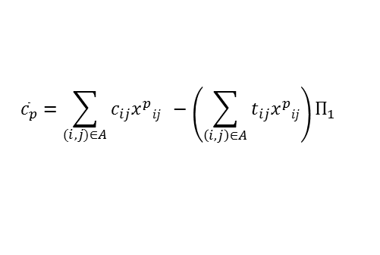
Column Generation
RMP:
+
+
+
+
+
…….
=
Run shortest path algorithm with modified costs:
2
4
Pricing Problem:
$${\overline{c}}_{p}=\sum_{(i,j)∈A}{c_{ij}{x_{}^{p}ij}_{}−\left(\sum_{\left(i,j\right)∈A}{t_{ij}x_{}^{p}ij}\right)Π_{1}}$$
1
6
3
5

Slide 29
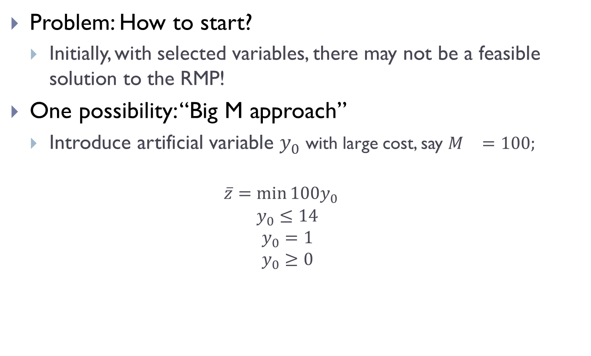
Example: Solving the LP relaxation
Problem: How to start?
Initially, with selected variables, there may not be a feasible solution to the RMP!
One possibility: “Big M approach”
Introduce artificial variable $y_{0}^{}$ with large cost, say $M_{}^{}=100;$
$${\overline{z}=\min{100y_{0}}}_{}^{}$$
$$y_{0}≤14$$
$$y_{0}=1$$
$$y_{0}≥0$$

Slide 30































Solving the LP relaxation
$${\overline{z}=\min{100y_{0}}}_{}^{}$$
$y_{0} ≤14$
$y_{0} =1$
$y_{0} ≥0$
$$+{ 3λ}_{1246}$$
$$+{24λ}_{1356}$$
$$+{ 15λ}_{13256}$$
$$+{ 5λ}_{1256}$$
$$+18λ_{1246}$$
$$+ 8λ_{1356}$$
$$+10λ_{13256}$$
$$+15λ_{1256}$$
$$π_{0}$$
$$+ λ_{1246}$$
$$+ λ_{1356}$$
$$+ λ_{13256}$$
$$+ λ_{1256}$$
$$π_{1}$$
$$, λ_{1246}$$
$$, λ_{1356}$$
$$, λ_{13256}$$
$$, λ_{1256}$$
Master Prob. Solution
$$\overline{z}$$
$$π_{0}$$
$$π_{1}$$
$\overline{c}$*
$$p$$
$$c_{p}$$
$$t_{p}$$
$y_{0}$= 1
100.0
100.0
0.00
-97.0
1246
3
18
$y_{0}$= 0.22, $λ_{1246}$ = 0.78
24.6
100.0
-5.39
-32.9
1356
24
8
$λ_{1246}$ = 0.6, $λ_{1356}$ = 0.4
11.4
40.80
-2.10
-4.8
13256
15
10
$λ_{1246}$ = 0.5, $λ_{13256}$ = 0.5
9.0
30.00
-1.50
-2.5
1256
5
15
$λ_{13256}$ = 0.2, $λ_{1256}$ = 0.8
7.0
35.00
-2.00
0.0
$π_{0} (dual):$ for every unit of variable used, extra cost added, or, the gain to be got by throwing out the variable.
Reduced cost: Gain obtained by increasing the value of the variable by one unit.

Slide 31
BRANCH-AND-BOUND + COLUMN GENERATION

Slide 32
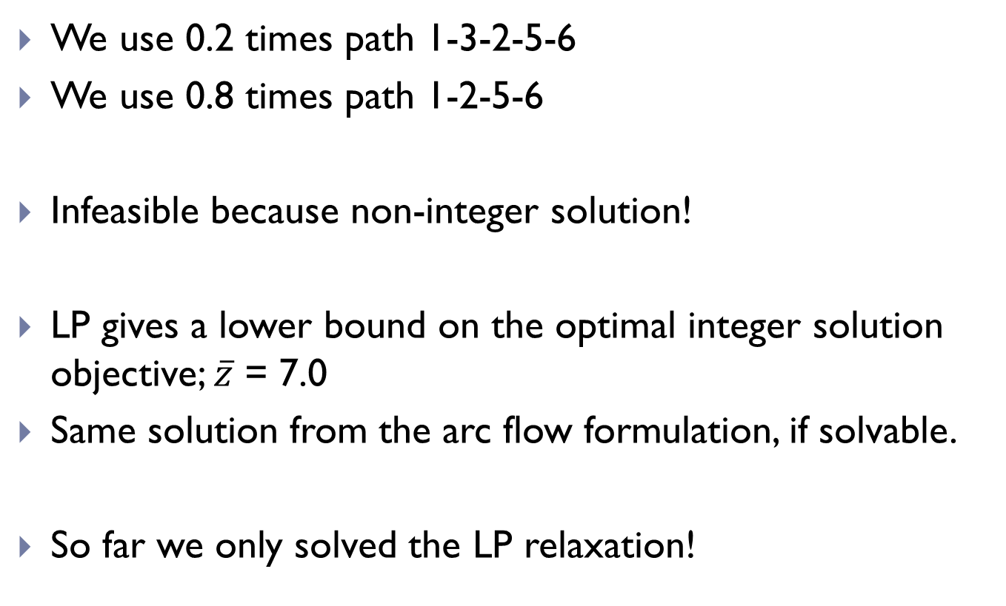
The RMP solution
We use 0.2 times path 1-3-2-5-6
We use 0.8 times path 1-2-5-6
Infeasible because non-integer solution!
LP gives a lower bound on the optimal integer solution objective; $\overline{z}$ = 7.0
Same solution from the arc flow formulation, if solvable.
So far we only solved the LP relaxation!

Slide 33
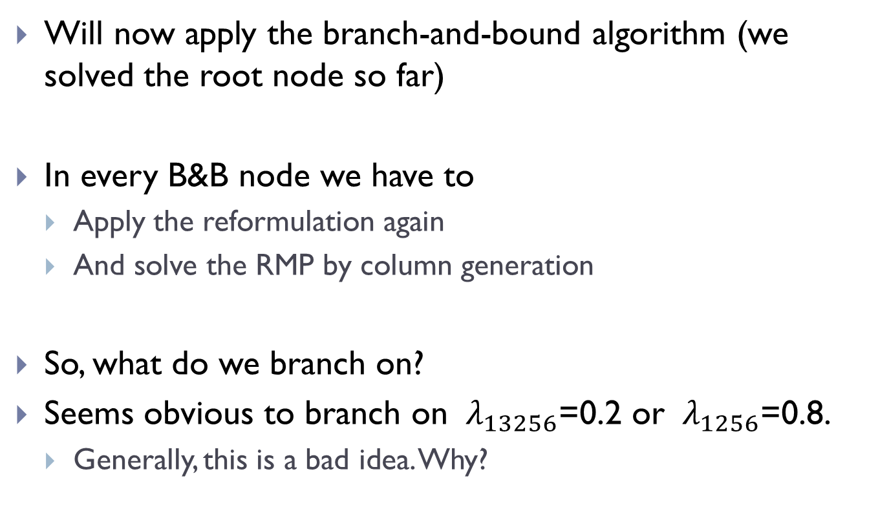
Integer Solutions
Will now apply the branch-and-bound algorithm (we solved the root node so far)
In every B&B node we have to
Apply the reformulation again
And solve the RMP by column generation
So, what do we branch on?
Seems obvious to branch on ${ λ}_{13256}$=0.2 or ${ λ}_{1256}$=0.8.
Generally, this is a bad idea. Why?

Slide 34
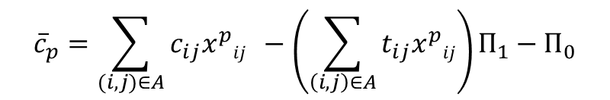
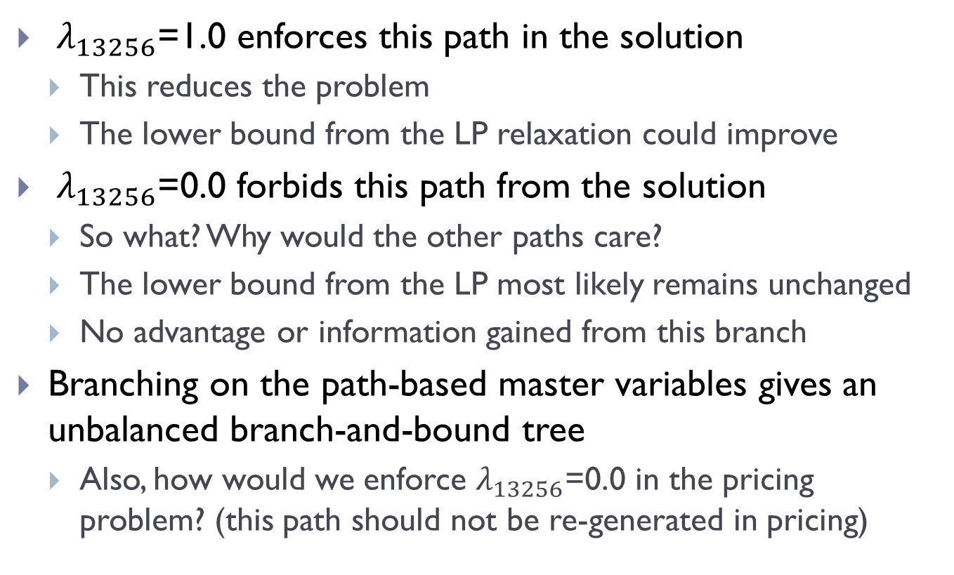
Branching on fractional paths
${ λ}_{13256}$=1.0 enforces this path in the solution
This reduces the problem
The lower bound from the LP relaxation could improve
${ λ}_{13256}$=0.0 forbids this path from the solution
So what? Why would the other paths care?
The lower bound from the LP most likely remains unchanged
No advantage or information gained from this branch
Branching on the path-based master variables gives an unbalanced branch-and-bound tree
Also, how would we enforce $λ_{13256}$=0.0 in the pricing problem? (this path should not be re-generated in pricing)
$${\overline{c}}_{p}=\sum_{(i,j)∈A}{c_{ij}{x_{}^{p}ij}_{}−\left(\sum_{\left(i,j\right)∈A}{t_{ij}x_{}^{p}ij}\right)Π_{1}−Π_{0}}$$

Slide 35


What else can we do?
Next obvious is to branch on fractional arc variables, like $x_{12}$=0.8
If we want to set $x_{12}$=0.0
Pricing problem: Arc (1,2) is removed from the graph
RMP: Variables ${ λ}_{1246}$and ${ λ}_{1256}$ must be eliminated; re-optimization will give ${ y}_{0}$>0, i.e., infeasible RMP.
2
(1,1)
4
Branch: $x_{12}$=0.0
(1,10)
(2,3)
(1,7)
Source node s
1
(1,2)
6
Sink node
t
(10,1)
(10,3)
(5,7)
(2,2)
3
5
(12,3)

Slide 36


Branching on fractional arc variables
Next obvious is to branch on fractional arc variables, like $x_{12}$=0.8
Pricing problem: Delete arcs (1,2) and (3,2) from the graph
RMP: Remove all path variables in RMP that contain these arcs
Try branching on original (arc) variables
2
(1,1)
4
Branch: $x_{12}$=1.0
(1,10)
(2,3)
(1,7)
Source node s
1
(1,2)
6
Sink node
t
(10,1)
(10,3)
(5,7)
(2,2)
3
5
(12,3)

Slide 37


Branching: Further Ideas
We can try to impose ‘richer’ constraints, e.g.: branch on ${ x}_{13}+x_{32}=0.4$
2
4
Branch: $x_{13}+x_{32}=0$
(1,10)
(2,3)
(1,7)
Source node s
1
6
Sink node
t
(10,1)
(5,7)
(2,2)
3
5
(12,3)
In subproblem: Arcs (1,3) and (3,2) are removed
In RMP: Variables corresponding to paths containing these arcs must be eliminated from RMP

Slide 38

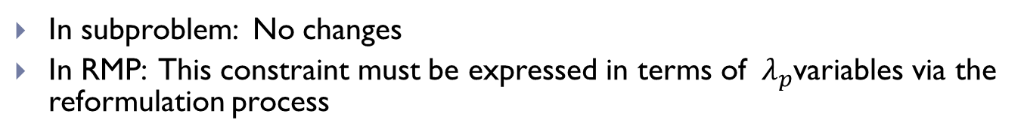
Branching: Further Ideas
We can try to impose ‘richer’ constraints, e.g.: branch on ${ x}_{13}+x_{32}=0.4$
2
4
Branch: $x_{13}+x_{32}≥1$
(1,10)
(2,3)
(1,7)
Source node s
1
(1,2)
6
Sink node
t
(10,1)
(10,3)
(5,7)
(2,2)
3
5
(12,3)
In subproblem: No changes
In RMP: This constraint must be expressed in terms of ${ λ}_{p}$variables via the reformulation process

Slide 39












Example continued: branch-and-bound tree
$$BB0$$
$$x_{13}+x_{32}=0$$
$$x_{13}+x_{32}≥1$$
$$BB1$$
$$BB2$$
$$Integer\overline{z}=14$$
$$x_{12}=0$$
$$x_{12}=1$$
$$BB3$$
$$BB4$$
$$Integer\overline{z}=13$$
$$Infeasible$$

